Slide 1
题目：MaskRCNN-Keypoints
2019.1.2

Slide 2
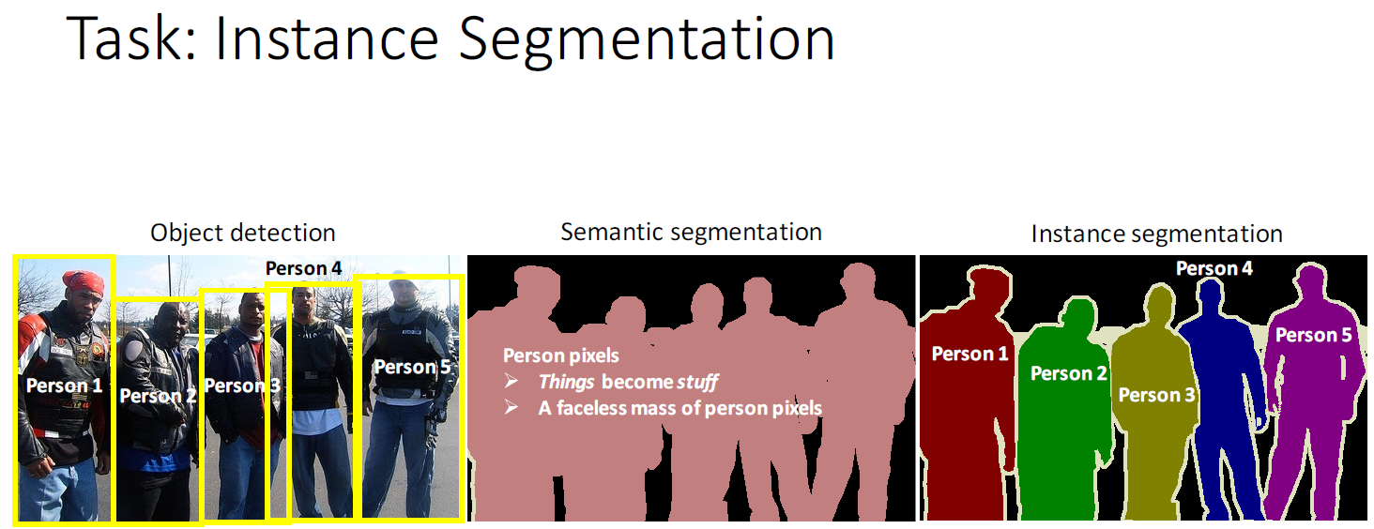
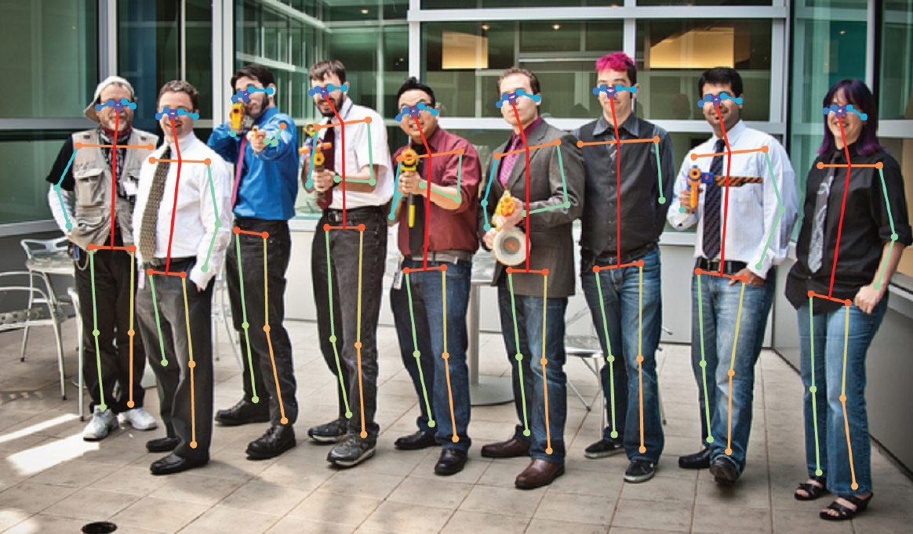
Person-keypoints
+

Slide 3
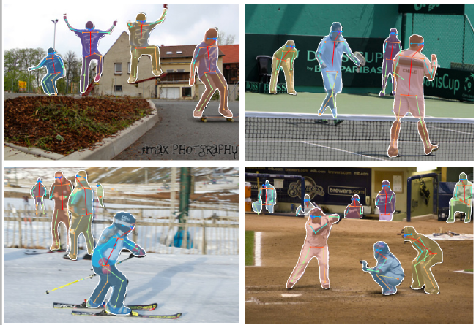

Slide 4
R-CNN家族发展史简介
R-CNN
Fast R-CNN
Faster R-CNN
Mask R-CNN

Slide 5
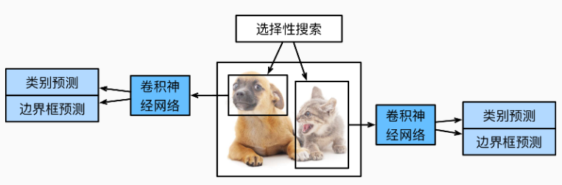
R-CNN

Slide 6
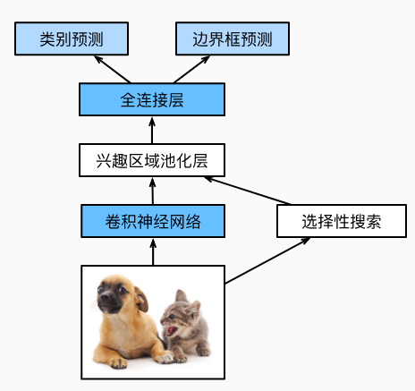
Fast RCNN

Slide 7
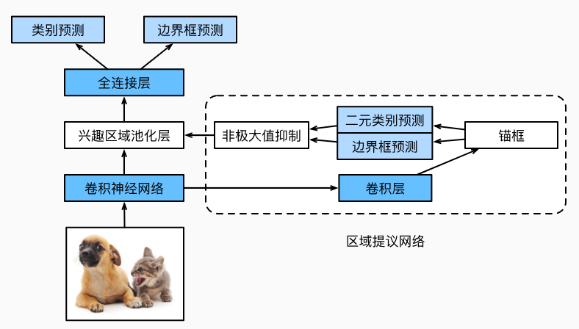
Faster RCNN

Slide 8
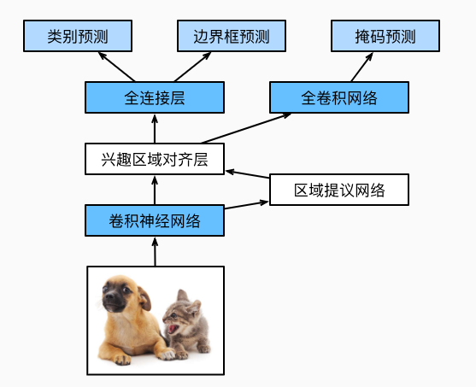
Mask RCNN

Slide 9
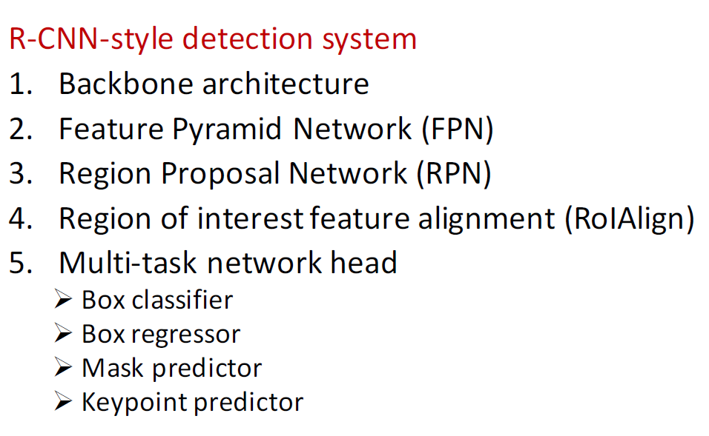
MaskRCNN-keypoints模型概述

Slide 10
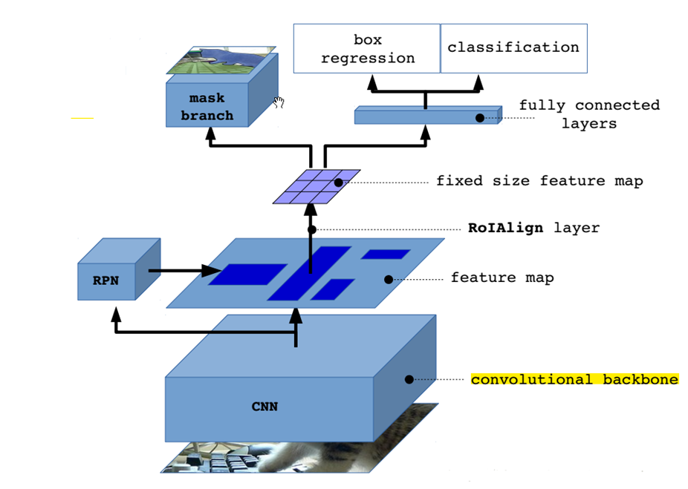
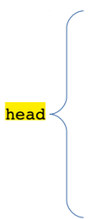
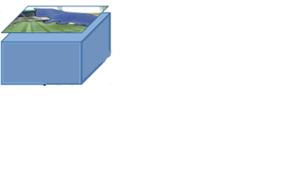
keypoint
branch
FPN

Slide 11
Backbone architecture
ResNet-50
ResNet-101
Remove pre-trained classification head, Backbone is fully convolutional

Slide 12
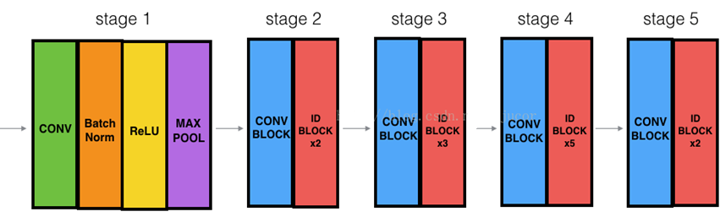
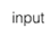

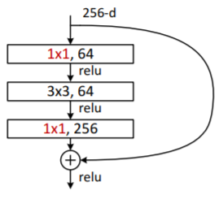
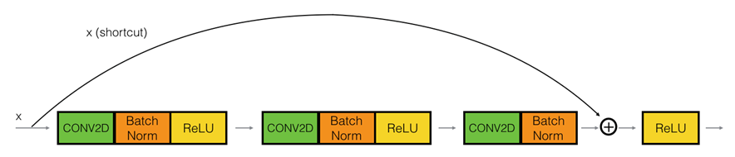
Backbone architecture——ResNet-50

Slide 13
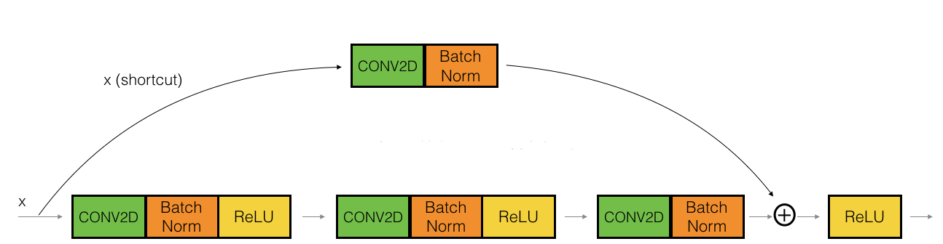
Backbone architecture——ResNet-50

Slide 14
Backbone architecture——ResNet-101
ResNet50 Stage4 ID BLOCK x5
ResNet101 Stage4 ID BLOCK x22

Slide 15
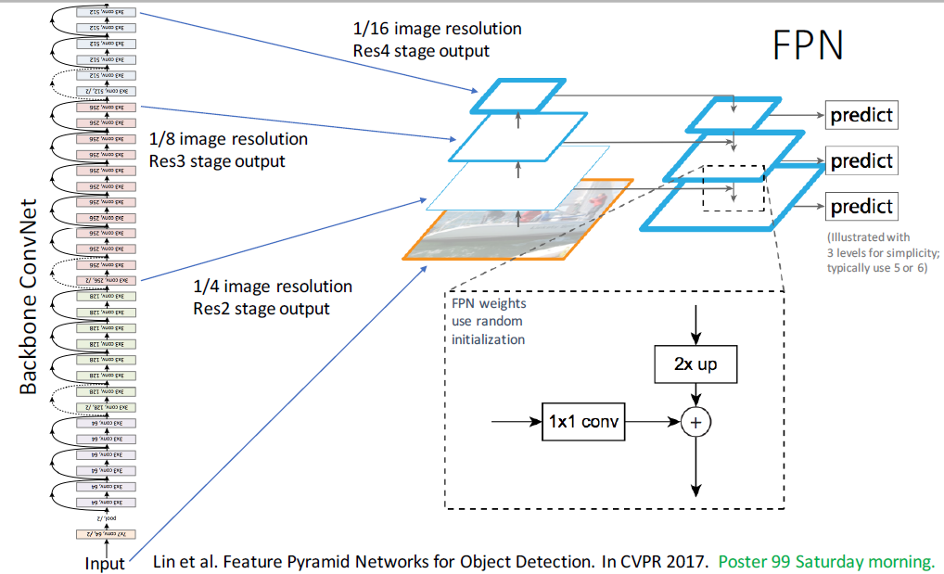
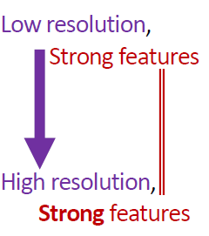

Slide 16
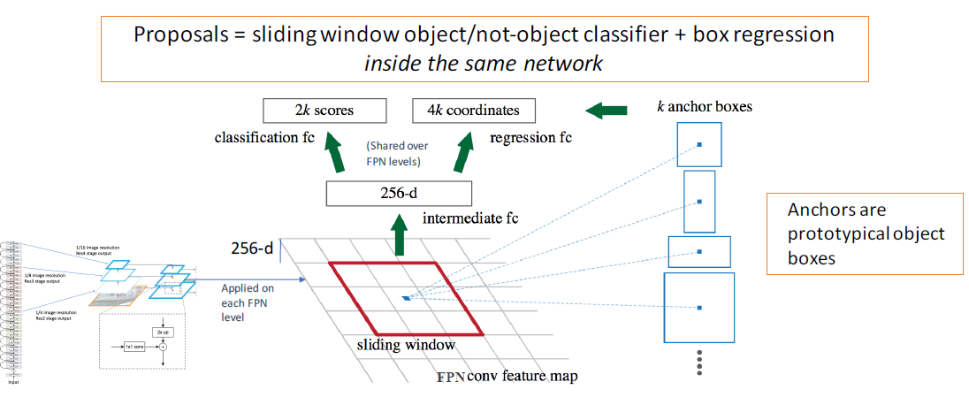
Region Proposal Network (RPN)

Slide 17
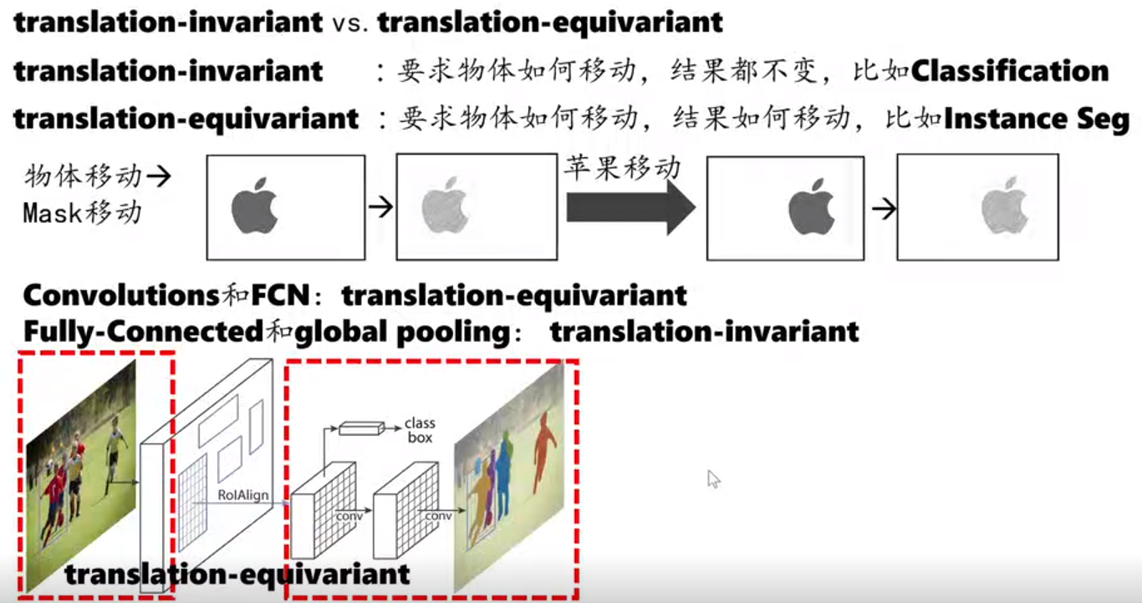
Translation-equivariant

Slide 18
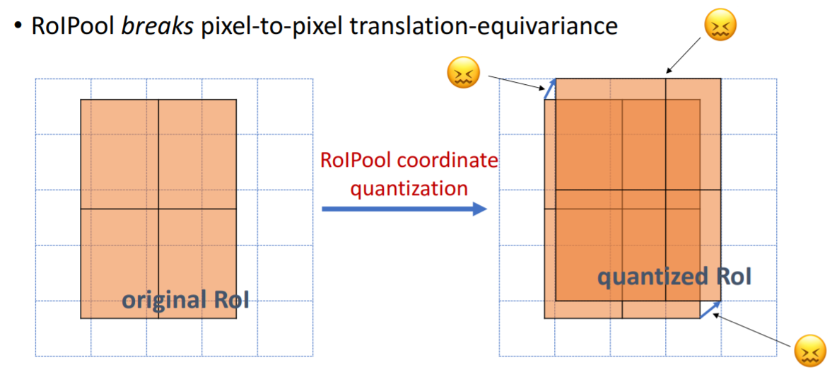
RoIPool

Slide 19
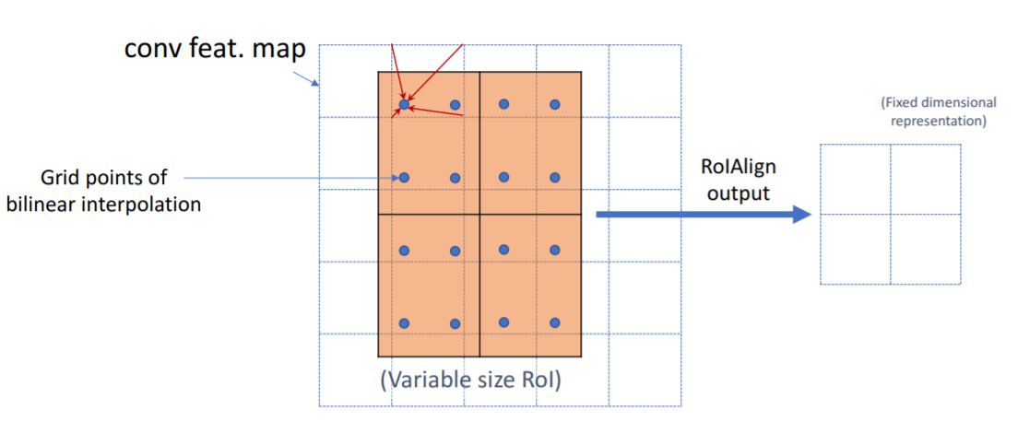
RoIAlign

Slide 20
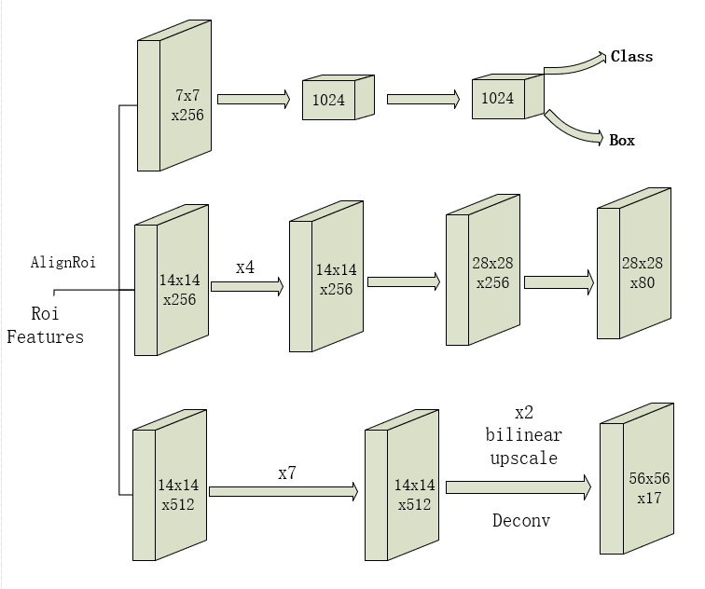
Mutil-task Network Heads
mask
keypoints

Slide 21
MaskRcnn-keypoint训练
利用pre-trained model进行在2014年COCO的train数据集微调，用val数据集进行测试。
具体如下：
Fine-tune multi-heads: 40 epochs
Fine-tune layers from ResNet stage 4 and up: 100 epochs
Fine-tune all layers: 60 epochs

Slide 22
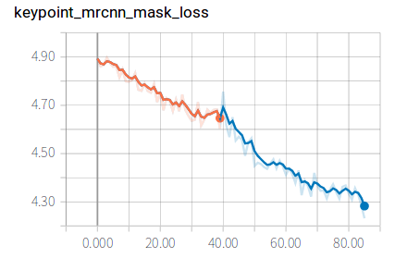
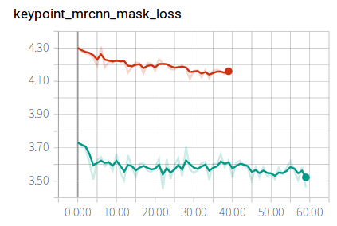
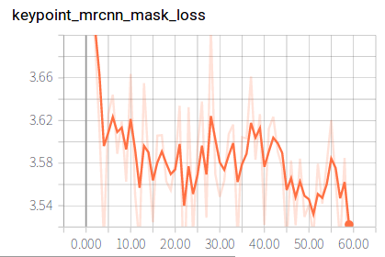
Loss曲线
40epochs for multi-heads+40epochs for stage4 and up
60epochs for stage4 and up
60epochs for all layers

Slide 23
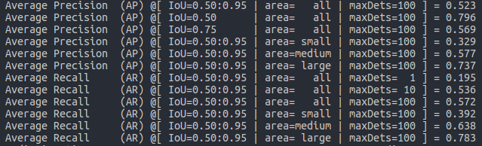
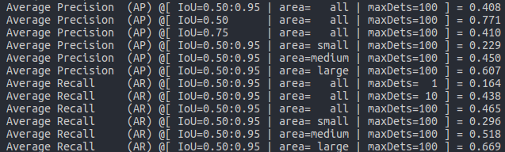
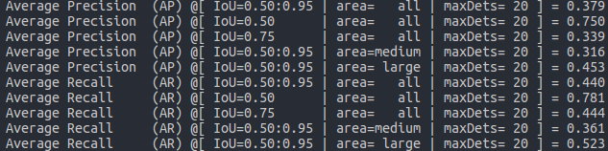
AP与AR
Bounding box
Segmentation
keypoint
Bounding box
Segmentation
keypoint

Slide 24
Video Presentation
Video link：https://v.qq.com/x/page/h0818szsb7f.html

Slide 25
Reference
https://blog.csdn.net/zjucor/article/details/78636573?locationNum=2&fps=1
http://deeplearning.csail.mit.edu/instance_ross.pdf
http://deeplearning.csail.mit.edu/cvpr2017_tutorial_kaiminghe.pdf
https://arxiv.org/pdf/1612.03144.pdf
https://arxiv.org/abs/1703.06870.pdf
http://blog.leanote.com/post/afanti.deng@gmail.com/b5f4f526490b
https://github.com/facebookresearch/maskrcnn-benchmark
https://github.com/chrispolo/Keypoints-of-humanpose-with-Mask-R-CNN
http://t.cn/EZyQjlc?m=4298669798749481&u=2706896955
https://zh.diveintodeeplearning.org/chapter_computer-vision/rcnn.html
https://v.qq.com/x/page/l0541v2py5k.html
http://cocodataset.org/#home
https://sites.google.com/view/cvpr2018-recognition-tutorial

Slide 26
Thanks!

Slide 27
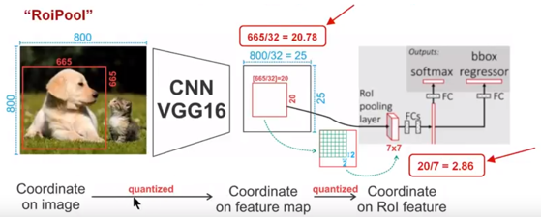
RoiPool

Slide 28
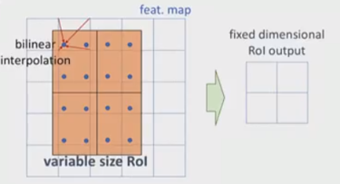
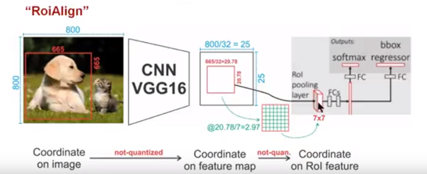
RoiAlign

Slide 29
